Slide 1
PROJECT OVERVIEW
Smart Diet Planner
Eat better. Live healthier. Track progress.

Slide 2

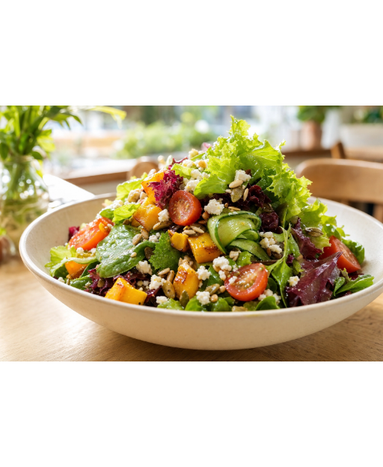
THE PHILOSOPHY
Why Choose Us?
Personalized Plans: Tailored physical goals.
Calorie Tracking: Monitor daily intake.
Healthy Recipes: Nutritious meal concepts.

Slide 3




Core Platform Features
Personalised Plan
Calorie Tracking
Healthy Recipes
Track Progress
Visual daily progress metrics.
Nutritious ingredient curation.
Consistent habit formation.
Goal-oriented dietary targets.

Slide 4
Starter Plan Generator
Dynamic diet generation based on user metrics.
1
2
3
Input Metrics
Define Goal
Generate Plan
Age and physical attributes.
Weight target selection.
Automated meal suggestions.

Slide 5
Explore Healthy Foods
Categorized nutritional database.
Searchable Interface
🍎
🥚
🌾
Fruits
Protein
Whole Grains
Natural fiber source.
Essential muscle support.
Sustained daily energy.
🥛
🥬
🫘
Plant Protein
Dairy
Vegetables
Vital calcium reserves.
Key micronutrient delivery.
Accessible nutrition source.

Slide 6
Daily Progress Dashboard
Interactive tracking for core health metrics.
💧
🏃
🥗
8
30
3
Glasses
Minutes
Meals
Hydration target.
Activity threshold.
Balanced eating.

Slide 7

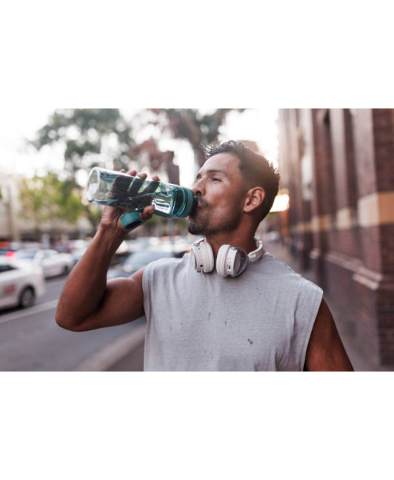
ARCHITECTURE
Technical Foundation
Semantic HTML5
Accessible document structure.
Custom CSS Logic
Responsive flexbox architecture.
JavaScript
Local storage state management.

Slide 8
Small choices build healthy habits.
Start tracking your progress today.
© 2026 Smart Diet Planner

